Slide 1
Continuous-Time Convolution
ECE 3793

Slide 2
Impulse Response
There are several ways to represent the input-output relationship of an LTI system
The first is directly expressing the output signal with respect to the input signal
  Example:
  We could solve this expression using diff. eq. methods for exponential and sinusoidal inputs….
  But what if the input is something different? Such as
The direct input-output relationship cannot always be solved easily for particular input signals
Another way of expressing the input-output relationship of a system, called the impulse response, enables us to determine the output of the system in response to any arbitrary input through a procedure called convolution

Slide 3

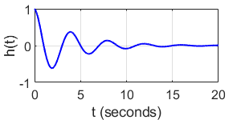


Impulse Response
The impulse response of a system is defined as the output of an LTI system when the input is a Dirac delta function
Commonly, system “blocks” are written with h(t) as a descriptor
Impulse response examples
  Hitting a punching bag
  Plucking a guitar string
LTI System
Standard notation for impulse response

Slide 4
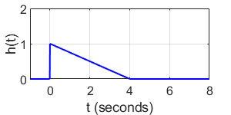
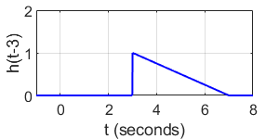
Impulse Response and LTI Properties
Suppose we have a system with the following impulse response
What if our input is a delayed delta function?
LTI System
Time-invariance allows us to just shift the impulse response

Slide 5
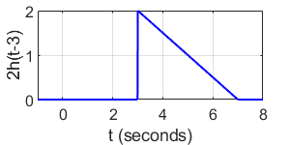
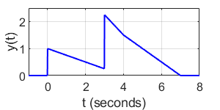
Impulse Response and LTI Properties
What if we scale the delta function?
What if our input is a sum of two delta functions?
Linearity (scaling) allows us to just scale the impulse response
Linearity (additivity) allows us to just add together the two outputs

Slide 6

Impulse Response and LTI Properties
By properties of linearity and time-invariance, any function that is a combination of time-shifted and amplitude scaled delta functions can be written as a corresponding sum of time-shifted and amplitude scaled impulse responses
We learned in a previous lecture that any continuous-time function can actually be written as an accumulation (integration) of scaled, shifted delta functions!
Note: this graphic is a little misleading, because it shows a gap between each delta function. In reality the delta functions are spaced infinitely closely
Scale the delta function by the value of x(t) at t=τ
Accumulate all the shifted, scaled delta functions for all values of τ from -infinity to infinity
Shift the delta function to be “on” at t=τ

Slide 7
The Convolution Integral
So if our input signal can be represented as an infinite accumulation (integral) of scaled, shifted delta functions…
Then by linearity, our output signal can be represented as an infinite accumulation (integral) of scaled, shifted impulse responses!
This result is called the convolution integral
Convolution is defined as:
Convolution is important because it allows us to compute the output of an LTI system given an impulse response and any arbitrary input signal.
x(t)
h(t)
y(t)
The input
The impulse response
of the LTI system
The output

Slide 8
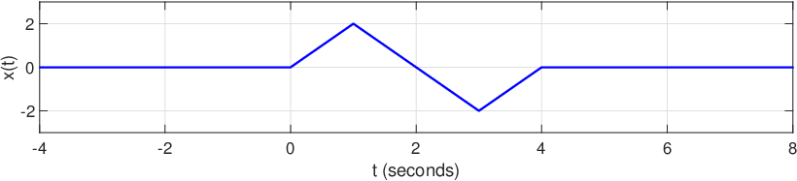
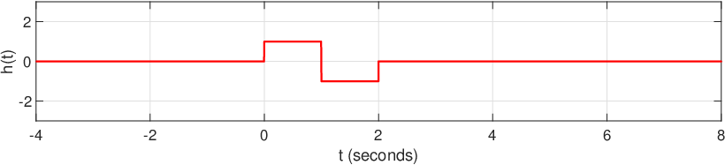
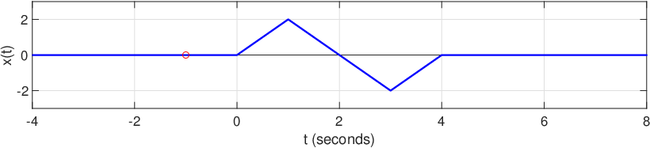
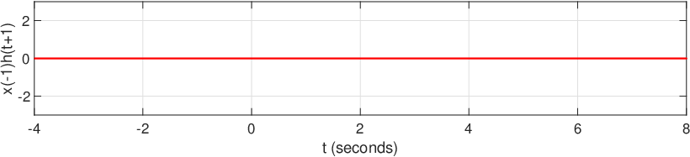
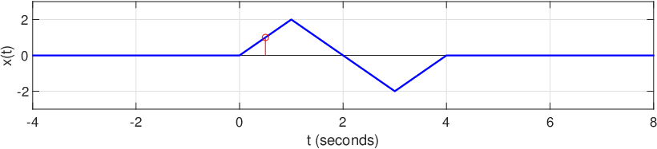
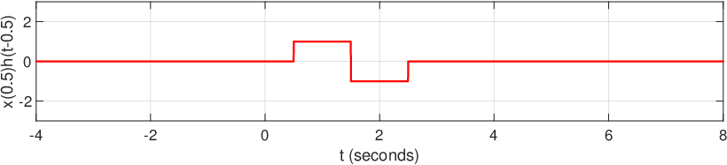
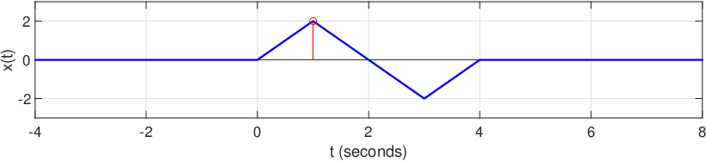
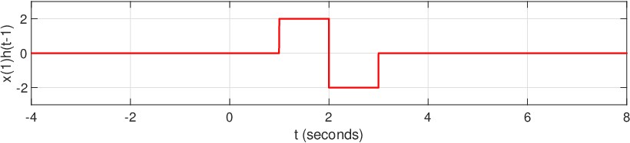
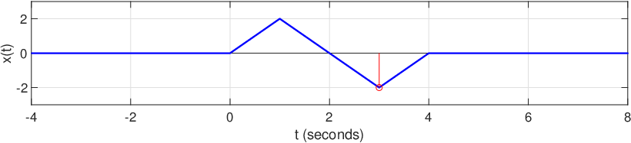
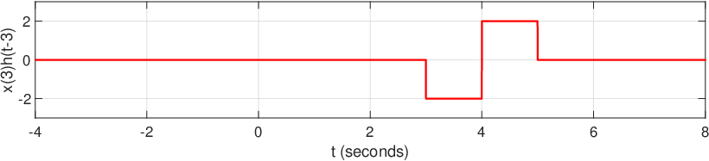
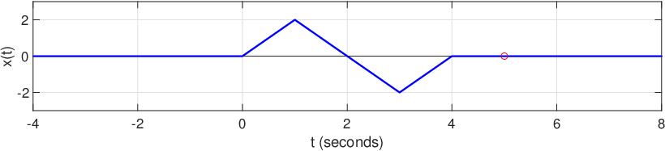
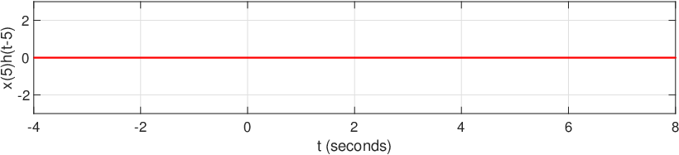
Visual Example of Convolution
Every point in time from x(t) (even when x(t)=0!) produces a scaled, shifted h(t)

Slide 9
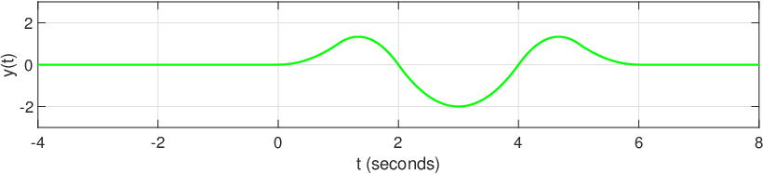
Visual Example of Convolution
If we add up every x(τ₀)h(t- τ₀) for every possible τ₀ (i.e., integrate), we get y(t)!

Slide 10
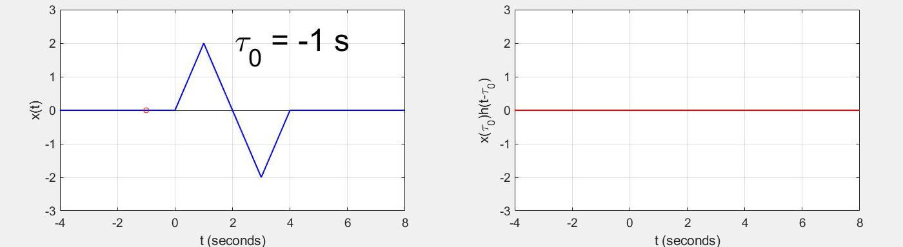
Visual Example of Convolution
If we add up every x(τ₀)h(t- τ₀) for every possible τ₀ (i.e., integrate), we get y(t)!

Slide 11
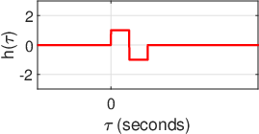
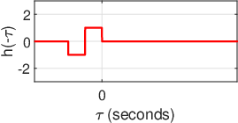
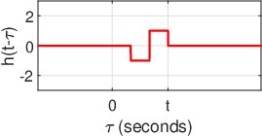
Another View of Convolution
Trying to sum up the impulse response for every value of τ won’t work well for actually solving integrals
Look again at the convolution integral…
For the purposes of integration, t is a constant while τ is the independent variable – new plots in terms of τ and not t!
Start with
Translate impulse response across τ=0 axis
Shift to the right by t (unique shift for all values of t)

Slide 12
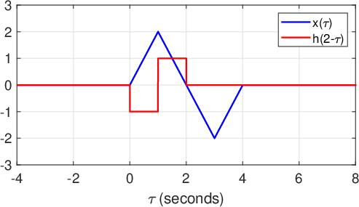
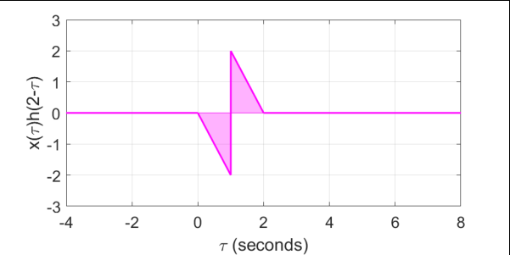
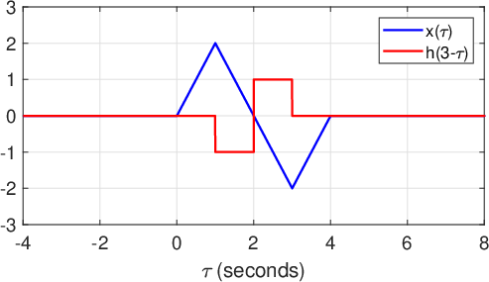
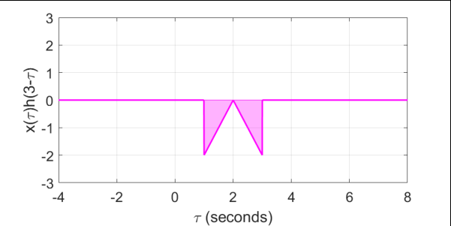
Another View of Convolution
Next, notice how x(τ) is stationary, independent of t
So, we multiply the flipped/shifted h(t-τ) with x(τ) and integrate the result to get the value of y(t)!
Example: t=2 (i.e., find y(2))
Example: t=3 (i.e., find y(3))

Slide 13
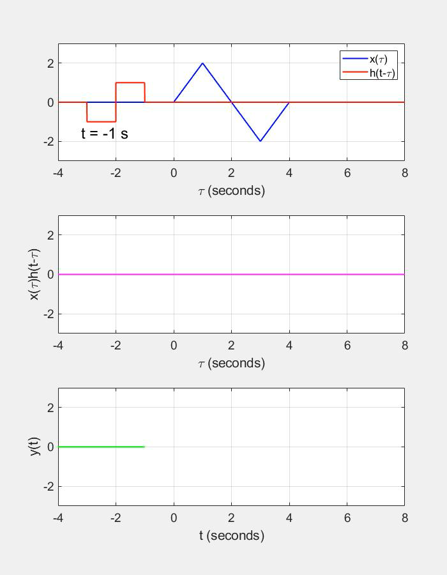
Visual Example of Convolution
We can “slide” the flipped impulse response to the right by increasing the value of t and integrating for all values of t, which produces the convolution output y(t)

